Slide 1
CHAPTER 1 INTRODUCTION TO STATICS
CHAPTER OUTLINE
1/1 Mechanics
1/2 Basic Concepts
1/3 Scalars and Vectors
1/4 Newton’s Laws
1/5 Units
1/6 Law of Gravitation
1/7 Accuracy, Limits, and Approximations
1/8 Problem Solving in Statics
By Duk.of.arch – www.flickr.com/photos/dukeofarch/Getty Images, Inc.

Slide 2
Article 1/1 Mechanics
Mechanics deals with the effects of forces on objects.
No other subject plays a greater role in engineering analysis.
Mechanics is the oldest of the physical sciences.
This course deals with the development and application of the principles of mechanics.
Statics is concerned with the equilibrium of bodies under the action of forces.

Slide 3
Article 1/2 Basic Concepts
Space
Time
Mass
Force
Particle
Rigid Body

Slide 4
Article 1/3 Scalars and Vectors
Scalar Quantity
A quantity with only a magnitude.
Examples: time, volume, density, speed, energy, and mass
Vector Quantity
Quantity with both a magnitude and a direction.
Obeys the parallelogram law of addition.
Examples: displacement, velocity, acceleration, force, moment, and momentum.

Slide 5
Article 1/3 – Types of Vectors in Mechanics
Types of Vectors
Free Vector – one whose action is not confined to or associated with a unique line in space.
Sliding Vector – has a unique line of action in space but not a unique point of application.
Fixed Vector – has a unique line of action and point of application.

Slide 6
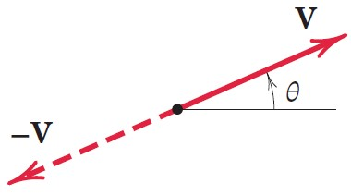
Article 1/3 – Conventions for Equations and Diagrams
Vector Representation
Line Segment with an Arrowhead to Indicate Direction
Written in Bold, Roman Type, e.g., V
Magnitude is Written in Lightface, Italic type, e.g., V
Always Distinguish between Scalars and Vectors
Use an underline, over-arrow, under-squiggle, etc., to represent vectors.
Failure to do so causes many mistakes in mechanics.

Slide 7
Article 1/3 – Working with Vectors (1 of 4)
Drawing Vectors
Line Segment with an Arrowhead to Indicate Direction
Reference Angle θ

Slide 8
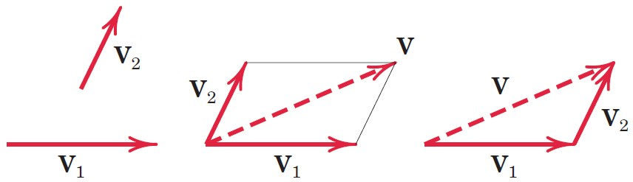
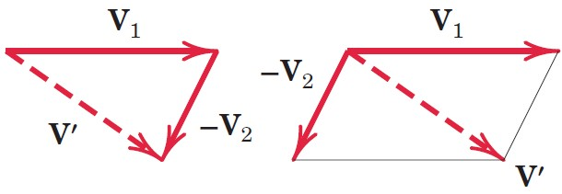
Article 1/3 – Working with Vectors (2 of 4)
Parallelogram Law of Addition – Vector Sum V = V₁ + V₂
Two Vectors, V₁ and V₂, treated as free vectors, may be replaced by their equivalent vector V, which is the diagonal of the parallelogram formed by V₁ and V₂. This is called a vector sum.
Vector Difference V′ = V₁ – V₂ (Adding a Negative)

Slide 9
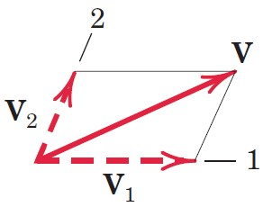
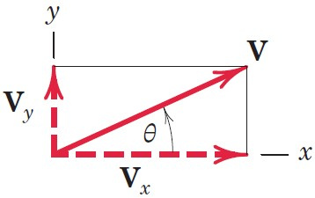
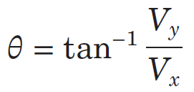
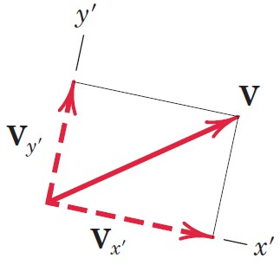
Article 1/3 – Working with Vectors (3 of 4)
Vector Components
Rectangular Components (x-y)
Axis Orientation

Slide 10
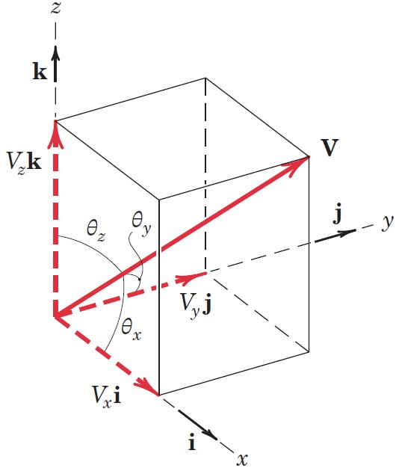
Article 1/3 – Working with Vectors (4 of 4)
Unit Vector Representation, V = Vn
A unit vector n has a magnitude of one (unity) and points in the direction of a vector.
Three-Dimensional Vectors and Direction Cosines
V = V_{x}i + V_{y}j + V_{z}k
V_{x} = V cos θ_{x} = Vl where l = cos θ_{x}
V_{y} = V cos θ_{y} = Vm where m = cos θ_{y}
V_{z} = V cos θ_{z} = Vn where n = cos θ_{z}
Pythagorean Theorem (Vector Magnitude)
V² = V_{x}² + V_{y}² + V_{z}²
l² + m² + n² = 1

Slide 11
Article 1/4 Newton’s Laws
Law I
A particle remains at rest or continues to move with uniform velocity (in a straight line with a constant speed) if there is no unbalanced force acting on it.
Law II
The acceleration of a particle is proportional to the vector sum of forces acting on it and is in the direction of this vector sum.
Law III
The forces of action and reaction between interacting bodies are equal in magnitude, opposite in direction, and collinear (they lie on the same line).

Slide 12
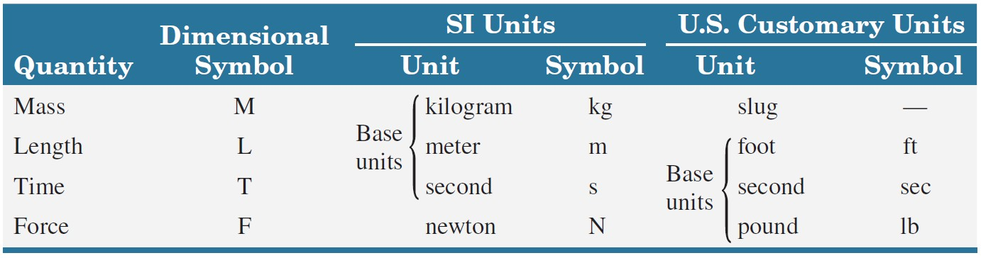
Article 1/5 Units
Fundamental Quantities of Mechanics and their Units

Slide 13
Article 1/5 – SI Units
Base Units
kilogram (kg)
meter (m)
second (s)
Derived Unit: Newton (N)
Force Unit
N = kg·m/s²

Slide 14
Article 1/5 – U.S. Customary Units
Base Units
pound (lb)
foot (ft)
second (sec)
Derived Unit: slug (slug)
Mass Unit
slug = lb-sec²/ft
Gravitational System

Slide 15
Article 1/5 – Primary Standards (1 of 2)
Mass
Mass of a specific platinum iridium cylinder kept at the International Bureau of Weights and Measures near Paris, France.
Length
The distance traveled by light in a vacuum in (1/299 792 458) second.
Time
The duration of 9 192 631 770 periods of the radiation of a specific state of a cesium-133 atom.

Slide 16
Article 1/5 – Primary Standards (1 of 2)
Acceleration of Gravity
SI Units: g = 9.806 65 m/s²
U.S. Units: g = 32.1740 ft/sec²
Values for Most Problems in Mechanics
SI Units: g = 9.81 m/s²
U.S. Units: g = 32.2 ft/sec²

Slide 17
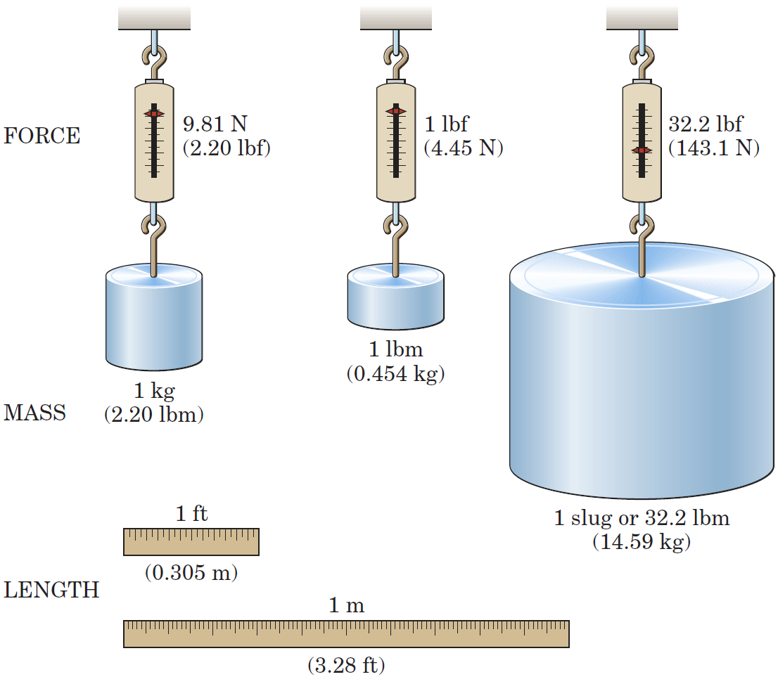
Article 1/5 – Unit Conversions
Visual Comparison of Force, Mass, and Length
A comprehensive list of unit conversion is available in Table D/5 of Appendix D.

Slide 18
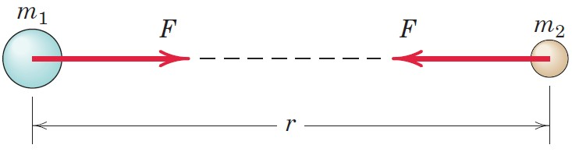
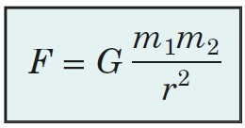
Article 1/6 Law of Gravitation
Mathematical Expression
F = the mutual force of attraction between two particles
G = a universal constant known as the constant of gravitation
m₁, m₂ = the masses of the two particles
r = the distance between the centers of the particles
Constant of Gravitation, G
SI Units: G = 6.673(10⁻¹¹) m³/(kg·s²)
U.S. Units: G = 3.439(10⁻⁸) ft⁴/(lb-sec⁴)

Slide 19
Article 1/6 – Gravitational Attraction of the Earth
Apparent Weight, W = mg
SI Problems
Mass m is always in kilograms (kg) and is almost always provided in the book.
Acceleration of gravity g = 9.81 m/s² (unless stated otherwise).
Weight W is in newtons (N).
Kilogram (kg) is not a force!
U.S. Problems
Mass m is always in slugs (slugs) and is almost never provided in the book.
Acceleration of gravity g = 32.2 ft/sec² (unless stated otherwise).
Weight W is in pounds (lb) and is usually what you are provided.
Pound (lb) is not a mass!

Slide 20
Article 1/7 Accuracy, Limits, and Approximations
Significant Figure Use in the Textbook
The textbook assumes that all given numbers are exact for simplicity.
If the first non-zero digit is a one (1), the textbook will record four (4) significant figures in the answer.
If the first non-zero digit is a two through nine (2-9), the textbook will record three (3) significant figures in the answer.
Retain all significant figures on intermediate calculations in a calculator, but only record answers or calculations according to the convention listed above.

Slide 21
Article 1/7 – Differentials
Order of Differential Quantities

Slide 22
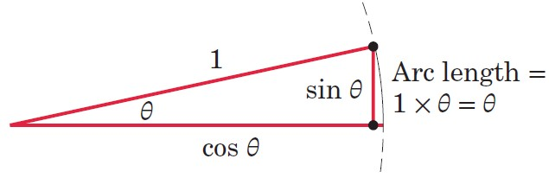
Article 1/7 – Small-Angle Approximations
Small Angle Approximations (with radians)
sin θ ≅ tan θ ≅ θ and sin dθ ≅ tan dθ ≅ dθ
cos θ ≅ 1 and cos dθ ≅ 1
Sample Calculation
1° = 0.017 453 rad, sin 1° = 0.017452, tan 1° = 0.017455, cos 1° = 0.999848
The percent error for the sine function is only 0.51% at 10°.
If more accuracy is required, retain the first two terms in the series expansion of the function.
To convert from degrees to radians, multiply the angle in degrees by π/180°.

Slide 23
Article 1/8 Problem Solving in Statics (1 of 4)
Dual Thought Process in Statics
Think about the physical situation and the corresponding mathematical description.
Make Appropriate Assumptions
Use Graphics
Representing a problem geometrically helps us with its physical interpretation. This is especially true for three-dimensional problems.
Graphical solutions can often be obtained more readily than with a direct mathematical solution.
Charts and graphs are valuable aids for representing results.

Slide 24
Article 1/8 Problem Solving in Statics (2 of 4)
Formulating Problems and Obtaining Solutions
Formulate the problem
State the given data.
State the desired result.
State your assumptions and approximations.
Develop the solution
Draw any diagrams you need to understand the relationships.
State the governing principles to be applied to your solution.
Make your calculations.
Ensure that your calculations are consistent with the accuracy justified by the data.
Be sure that you have used consistent units throughout your calculations.
Ensure that your answers are reasonable in terms of magnitudes, directions, common sense, etc.
Draw conclusions.

Slide 25
Article 1/8 Problem Solving in Statics (3 of 4)
The Free-Body Diagram
Isolation of a Body from all other Interacting Bodies
Developed Fully in Chapter 3
Single Most Important Step in Equilibrium Problems
Numerical Values versus Symbols
Symbolic Solutions Advantages
Helps to focus attention on the connection between the physical situation and its related mathematical description.
Can be used repeatedly for obtaining answers to the same type or problem but having different units or numerical values.
Enables dimensional checks at every step to ensure dimensional homogeneity.

Slide 26
Article 1/8 Problem Solving in Statics (4 of 4)
Solution Methods
Obtain mathematical solutions by hand, using either algebraic symbols or numerical values. We can solve most problems this way.
Obtain graphical solutions for certain problems.
Solve problems by computer. This is useful when a large number of equations must be solved, when a parameter variation must be studied, or when an intractable equation must be solved.

Slide 27
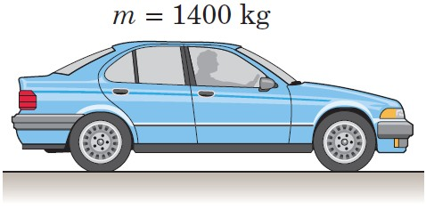
Article 1/9 – Sample Problem 1/1 (1 of 2)
Problem Statement
Determine the weight in newtons of a car whose mass is 1400 kg. Convert the mass of the car to slugs and then determine its weight in pounds.

Slide 28
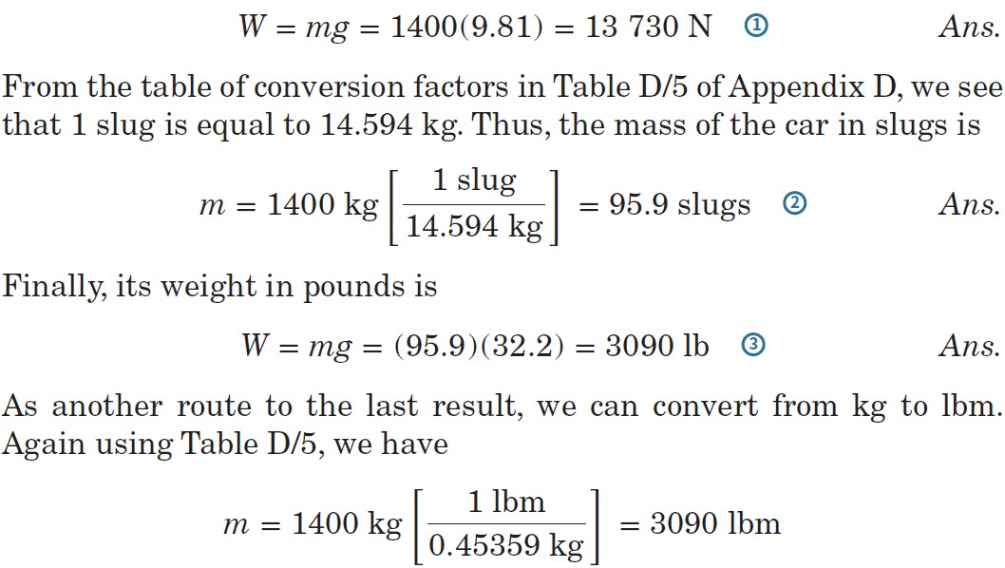
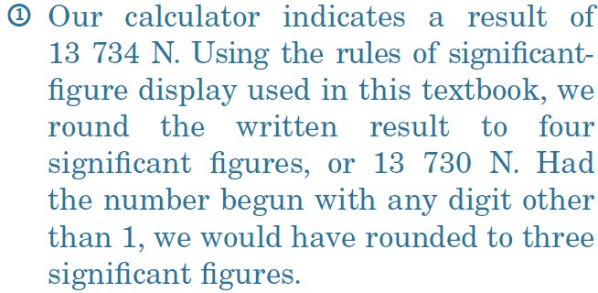
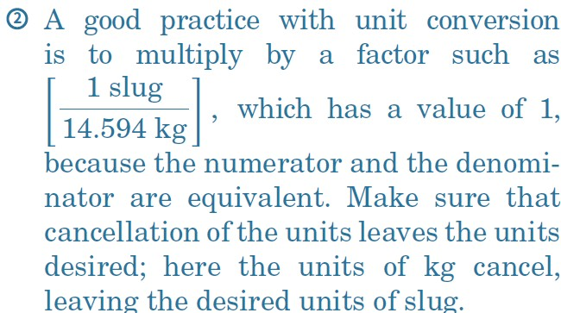
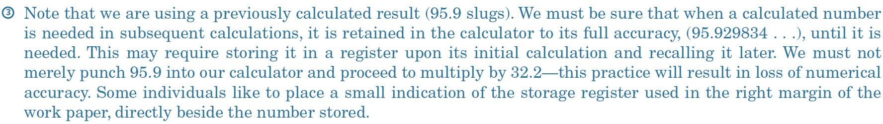
Article 1/9 – Sample Problem 1/1 (2 of 2)
Solution

Slide 29
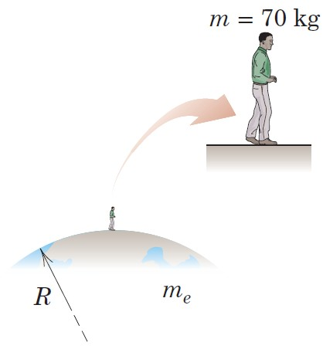
Article 1/9 – Sample Problem 1/2 (1 of 2)
Problem Statement
Use Newton’s law of universal gravitation to calculate the weight of a 70-kg person standing on the surface of the earth. Then repeat the calculation by using W = mg and compare your two results. Use Table D/2 as needed.

Slide 30
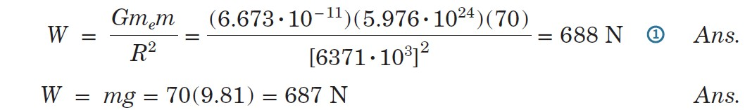
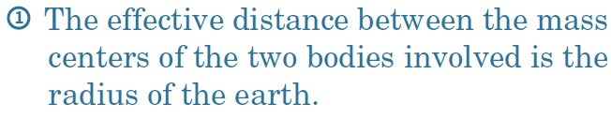
Article 1/9 – Sample Problem 1/2 (2 of 2)
Solution

Slide 31
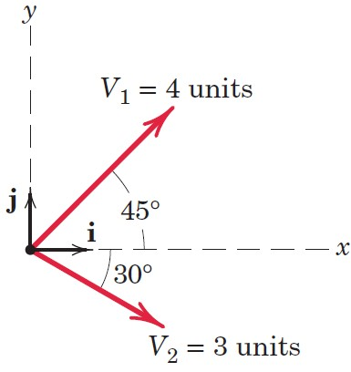
Article 1/9 – Sample Problem 1/3 (1 of 3)
Problem Statement
For the vectors V₁ and V₂ shown in the figure,
determine the magnitude S of their vector sum S = V₁ + V₂
determine the angle 𝛼 between S and the positive x-axis
write S as a vector in terms of the unit vectors i and j and then write a unit vector n along the vector sum S
determine the vector difference D = V₁ − V₂

Slide 32
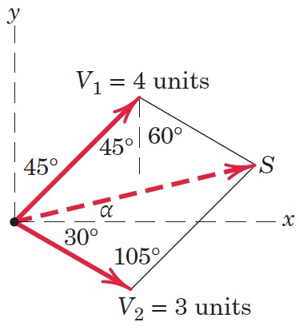
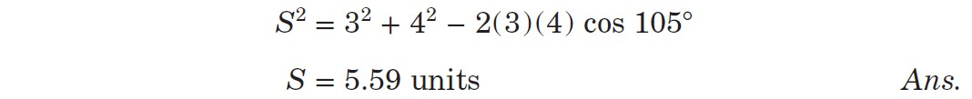
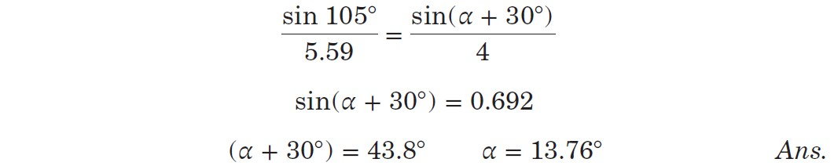
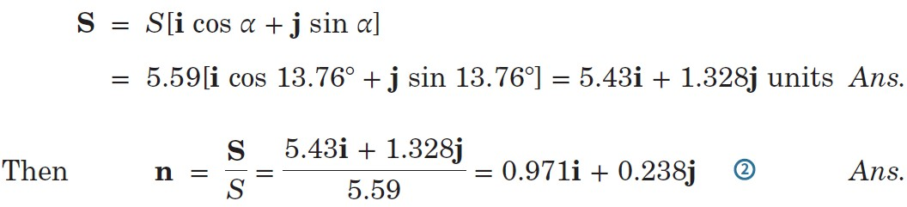
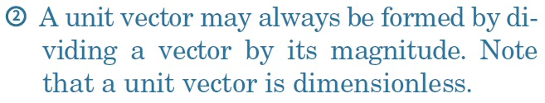
Article 1/9 – Sample Problem 1/3 (2 of 3)
Part a) – Magnitude of S
Part b) – Angle Between S and x-axis
Part c) – Vector Expression for S and n

Slide 33
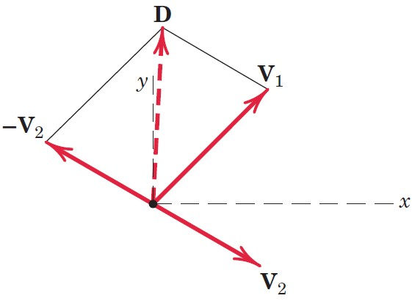
Article 1/9 – Sample Problem 1/3 (of 3)
Part d) – Vector Difference

